Slide 1

Major Project
Group D

Slide 2
Design Objectives
Our primary objectives for this project are as follows:
Create a technology to improve easy of use for modern supermarkets,
Implement a modular design to allow better scalability and maintenance.

Slide 3
Technology concept
Our concept is a self-navigating shopping trolley that follows a customer through a supermarket.
The system will always stay within a given distance of the user
The system will sound an alarm if the user gets too close to the trolley
The system will display the distance to the user on a 7-segment display

Slide 4
Proof of Concept Technology
As a proof of concept, our design will demonstrate the object tracking element of our design.
The system can track the user and output the distance and angle of the user.
Our concept is queried through the terminal, allowing users to gain live updates of the system status, user distance, and user angle.

Slide 5
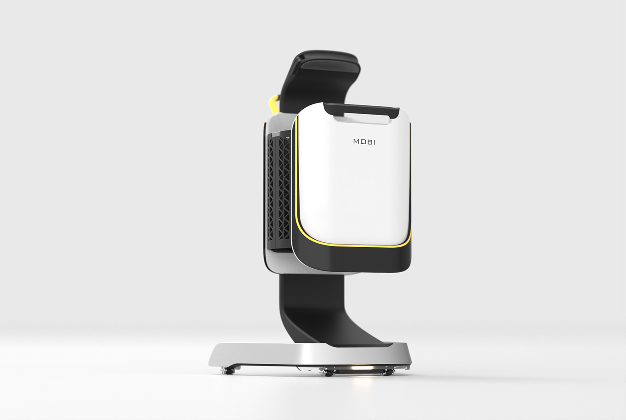
Industry Need for Concept
With increasing automation of shopping experiences, there is little room left for innovation.
There is room however in accessibility and ease of access.
The age of convenience constantly demands ease of use
The market has some competition [1] (see MOBI on right), although these systems rely on GPS tracking of mobile devices rather than object detection.
As a result, our system will have greater market penetration as a result of better usability.

Slide 6
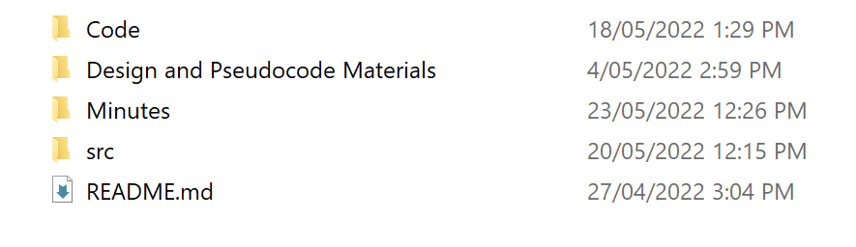
Documentation
Our project has been created and documented through GitHub:
Each group meeting has a minutes document
Project itself is outlined in README document.

Slide 7

Project Timeline
Scheduled timeline for project

Slide 8
Module Design
Our project has been split into five modules:
Serial module: handles error outputs, user queries and outputs corresponding messages
Sound & visual module: flashes and beeps corresponding to user distance from system
Status module: monitors orientation and acceleration of system
Object detection module: detects an object in front of the system
Control module: tracks position of object and outputs distance/angle of object

Slide 9
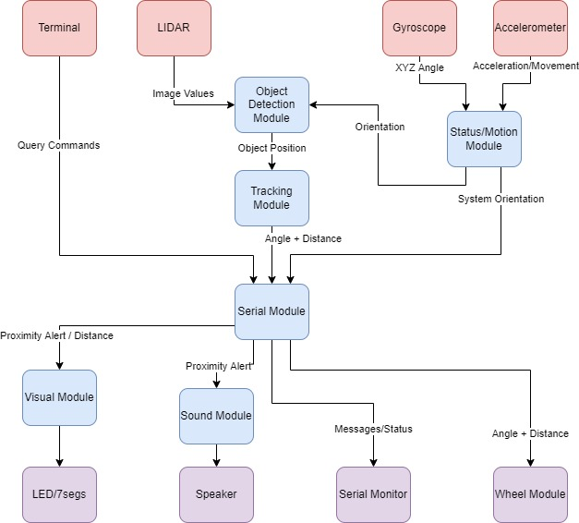
Module Interface and Free Body Diagram
Module | Inputs | Outputs
Serial Module | Queries User angle/distance Error messages | Error Messages Angle/distance
Audio/Visual Module | User distance | Sound/lights
Status Module | Gyroscope values Accelerometer values | System orientation System acceleration
Object Detection Module | LIDAR values System orientation | Object position
Control Module | Object position | User angle/distance

Slide 10
Roles and Responsibilities
Roles for this project were spread evenly among the group, with each member acting as the primary for one module.
Roles | Primary | Secondary | Support
Serial module | Will | Joon
Audio/visual module | Ethan
Status module | Joon
Object tracking module | Taj
Control module | Josh | Taj
Documentation | Will | Ethan

Slide 11
Serial Module PSEUdoCode
Serial Output
Function called
Load argument into buffer and end buffer with null
Update message to send bit/register to true
Check whether terminal ready to receive
If ready to receive, transmit character by character until null reached Update message to send bit/register to false
Clear buffer
Serial Input
If receive interrupt triggered
While message waiting to be received, read character by character into buffer
Update message to receive bit/register to false once null character received

Slide 12
AUDIO/Visual Module PseudoCode
Sound Module
Take in distance b/w cart and user (maybe via function call)
If user is too close beep
Beep at variable lengths based on distance
Visual Module
Take in distance b/w cart and user (maybe via function call)
Convert integer values to array of digits example:
(assumed max distance = 40m, therefore max digits = 2)
Distance = 2, array = [0, 2], displayed “02”
Distance = 13, array = [1,3], displayed “13”
Convert to seven seg values
Send to 7-seg display

Slide 13
Status Module PseudoCode
Calibrate
Get current gyro readings
Store readings in the gyro offset variable
Get current accelerometer readings
Calculate the magnitude and scale it to 9.81
Store calculated value in the accel scale variable
Get gyro/accel
Get current raw readings
Offset and scale gyro/accel readings with values calculated during calibration
Return values
Get tilt
Get the y-component of the accelerometer and take inverse cosine to get angle
If it is greater than 45° it is tipped over

Slide 14




Object Detection PseudoCOde
Movement
Performs basic functionality
Converting LIDAR to distance
Timing sections of code
Updating arrays
Tracking
Begin centred on user
Pan until an edge is detected
Edge appears as discontinuity in distance readings
Pan direction is switched when an edge is detected
Outputs a range of values such as movement speed, angular location of object.
Includes control measures such as error output when tracking is lost

Slide 15
CONTROL PseudoCode
Direction Calculator
Access shopper struct for reference distance and angles
Calculate the difference from reference and measured distance/angles
Decide whether right or left (angle) forward or back (distance)
Combine distance and angles with direction in one instruction string – to be outputted when queried
Distance and Angle Geometry
Passed in the edge bounds of the shopper
Using geometry
Calculates the distance away the shopper is from the trolley
Calculates the angle at which the shopper is from the trolley

Slide 16
Technology Demonstration

Slide 17
Scalability and Further Development
Given a larger budget and expanded team, we hope to fully develop our system.
Doing so would involve making the system mobile and operational at higher speeds. This will be achieved through:
Higher-quality components
Larger amounts of testing
More software development time

Slide 18

Thank You
someone@example.com

Slide 19
References
Chan woo, P., Chan Young, C., & Eun ji, L. (2019, June 2). MOBI. Retrieved from Behance: https://www.behance.net/gallery/81048169/MOBI

